Slide 1
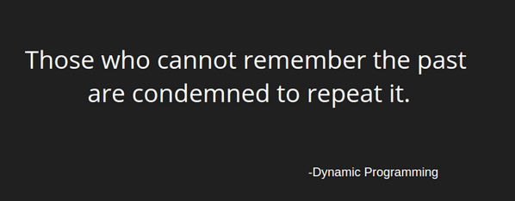
DYNAMIC PROGRAMMING
-Namrata Prasad
-181210032
-CSE 2ND YEAR

Slide 2
DESCRIPTION
Dynamic Programming is mainly optimization over plain recursion.The idea is to simply store the results of subproblems, so that we do not have to re-compute them when needed later. This simple optimization reduces time complexities from exponential to polynomial.
The intuition behind dynamic programming is that we trade space for time.

Slide 3
PROBLEM SOLVING
Majority of the Dynamic Programming problems can be categorized into two types:
1. Optimization problems.-
Which expect you to select a feasible solution, so that the value of the required function is minimized or maximized.
2. Combinatorial problems.-
Which expect you to figure out the number of ways to do something, or the probability of some event happening.
There are following two different ways to store the values so that the values of a sub-problem can be reused :
Tabulation: Uses Bottom Up approach
Memoization: Uses Top Down approach

Slide 4
ALGORITHM
Steps to solve a DP
1) Identify if it is a DP problem
2) Decide a state expression with least parameters
A state can be defined as the set of parameters that can uniquely identify a certain position or standing in the given problem. For example: In the Knapsack problem, we define our state by two parameters index and weight
3) Formulating a relation among the states
4) Do tabulation (or add memoization)
Store the state answer so that next time that state is required, we can directly use it from our memory

Slide 5
APPLICATIONS
0/1 knapsack problem.
Travelling Salesman Problem
Matrix Chain Multiplication
Mathematical optimization problem.
All pair Shortest path problem.
Longest common subsequence (LCS)
Flight control and robotics control.
Time sharing: It schedules the job to maximize CPU usage.

Slide 6
PROBLEM STATEMENT
Vaishu plays a video game consisting of L levels and N obstacles. The game allows you to cross a level only after you have passed all the obstacles present in that particular level. Obstacles are numbered from 0 to N-1. After you cross any level, it gets unlocked for playing when ever you want for fun.
Vaishu by mistake had deleted the game from her system. Fortunately, after installing back again, all the levels that she cleared still remain unlocked but she needs to pass all obstacles again. Now, she cannot move to the next level until all the obstacles are passed again.
The rules of the game have changed slightly now. Following are the rules she needs to follow to pass all the obstacles.
As all levels are already unlocked, so she can play levels in any order.
For every level that she decides to play again, she has to pass all the obstacles present within it before deciding to play any other level that has not been crossed yet. But, it is possible that she has passed some obstacles as the levels are being played in random order. So, if she passes X new obstacles, then she incurs a loss of X^{m} experience points in that level, where M is the player difficulty multiplier defined by game itself and is constant for all levels. At every level, she will incur some loss of experience points that she had earned throughout her game.
Only thing she wants now is that minimum experience points are deducted. So, she needs your help to find the minimum experience points that will be deducted for passing all the obstacles across all the levels.

Slide 7
DP APPROACH
Create a vector of vectors which stores the different obstacles to be crossed at each level.
Create a dp array to keep a check if the obstacle has been crossed (initialize with 0's)
points=0
While size of vector>0,repeat steps 5-8
min= level with minimum number of obstacles.
points=points+(size of the vector[min])^{m}
Mark all the obstacles crossed in the dp array and delete the marked obstacles from all the remaining levels
Delete vector[min] //size of vector decreases by 1.

Slide 8
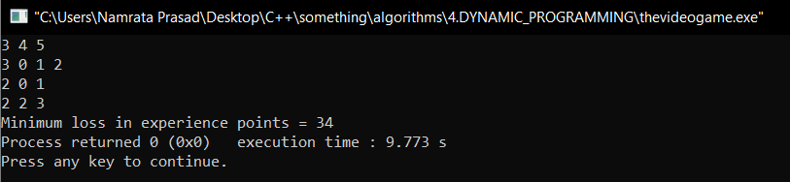
OUTPUTS
Input Format:
First line of the input contains three single space separated integers L, N and M denoting the number of levels Vaishu has unlocked, total number of distinct obstacles throughout the game and player difficulty multiplier respectively.
Each of next L lines contains an integer H denoting the number of obstacles she need to pass for that level, followed by list of H obstacles each one ranging between 0 to N-1 that she need to pass for that level.
INPUT 1:

Slide 9
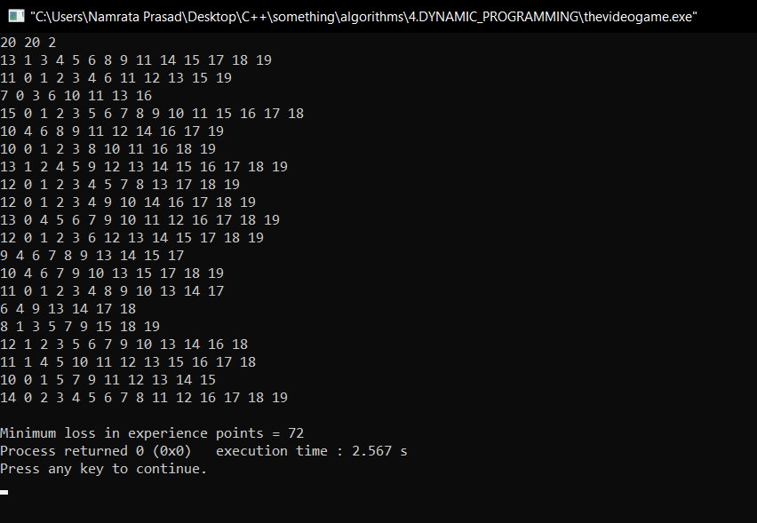
INPUT 2:

